Slide 1
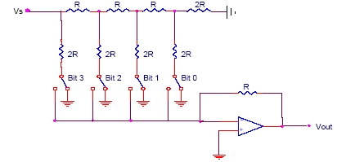
R-2R Ladder
Each bit corresponds
to a switch:
If the bit is high,
the corresponding
switch is connected to
the inverting input of
the op-amp.
If the bit is low, the
corresponding switch
is connected to ground.
V_{ref}
Bit: 0 0 0 0
V_{out}
4-Bit Converter

Slide 2
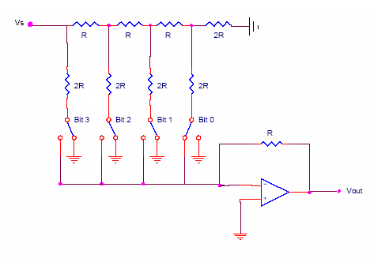
R-2R Ladder
V₃
V_{ref}
V₁
V₂
V₃
Ideal Op-amp
2R
2R

Slide 3
R-2R Ladder
V_{ref}
V₁
V₂
V₃
V₂
V₃
R
R
I
Likewise,
V_{out}

Slide 4
R-2R Ladder
Results:
V_{ref}
V₁
V₂
V₃
Where b₃ corresponds to bit 3,
b₂ to bit 2, etc.
If bit n is set, b_{n}=1
If bit n is clear, b_{n}=0
V_{out}

Slide 5
R-2R Ladder
For a 4-Bit R-2R Ladder
For general n-Bit R-2R Ladder or Binary Weighted Resister DAC

Slide 6
R-2R Ladder
Advantages
Only two resistor values (R and 2R)
Does not require high precision resistors
Disadvantage
Lower conversion speed than binary weighted DAC

